Slide 3
Contents
Summary of the history of neuroscience
Video animation link
Summary of key points about brain development from childhood to adolescence (which support animation video)
Lesson Activity suggestions which include in class psychological experiments
Resources
* Please note there are notes on some of the slides to further explain them

Slide 4
The History of Neuroscience

Slide 5
A Timeline of Neuroscience between 1900-2000
Neuroscience is the study of the brain and nervous system
While the brain and mind have been of interest to philosophers and medics throughout history, it wasn’t really until the invention of the microscope and the development of a famous cell staining technique (Golgi’s silver staining technique) at the end of the 19th century that the study of neuroscience began to take off!
1911 Aptly named British neuroscientist Henry Head publishes “Studies in Neurology.”
1929 Hans Berger invents the EEG (electroencephalography), a device that measures electrical activity in the brain.
1932 Lord Edgar Douglas Adrian and Sir Charles S. Sherrington win the Nobel Prize for describing how neurons transmit messages.
1938 Isidor Rabi discovers nuclear magnetic resonance, facilitating the development of magnetic resonance imaging (MRI). Rabi’s discovery would go on to win the Nobel Prize in 1944.
1950 Karl Spencer Lashley determines that memory relies on several sites in the brain working together.
1970 The Society for Neuroscience is established.
1973 Candace Pert discovers opiate receptors in the brain.
1974 A mouse is the subject of the first nuclear magnetic resonance (NMR) scan.
1974 The first Positron Emission Tomography (PET) scanner is invented, providing visual information about brain activity.
1987 Prozac is introduced.
1990 George H. W. Bush declares the last decade of the 20th century as the Decade of the Brain.
1992 Functional magnetic resonance imaging (fMRI) is first used to map activity in the human brain. Neuroscience booms.
Source: https://brainworldmagazine.com/a-very-brief-history-of-neuroscience/

Slide 6
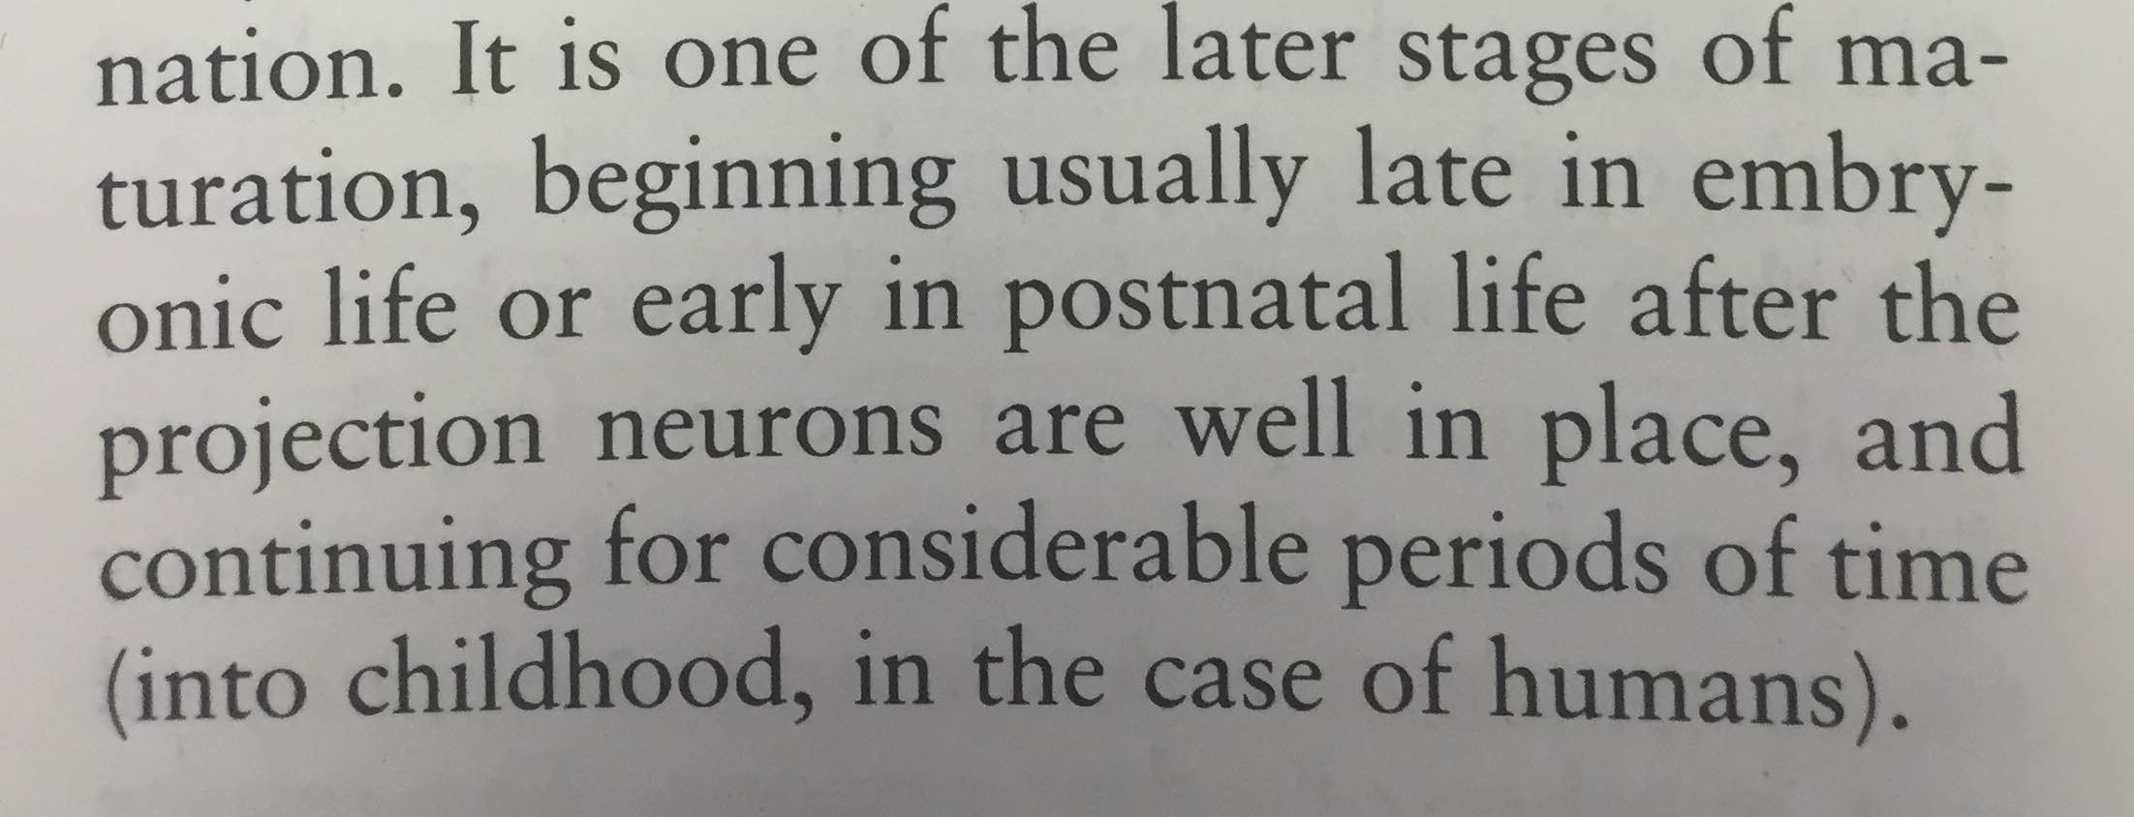
Cognitive Neuroscience
Cognitive Neuroscience – the study of how are brains are involved in cognition – the mental processes that underlie behaviour, thought and experience
Very little used to be known about brain development past infancy
Neuroscience Textbook (1995)
Notes:
So neuroscience is the study of the brain, but what about cognitive neuroscience? Cognitive neuroscience is the study of how are brains are involved in cognition – the mental thought processes we do everyday - things like memory, learning, paying attention, and our emotions. Until quite recently, scientists knew almost nothing about brain development in adolescence, and it was assumed that most brain development happened in the first few years of life! But scientists now know this isn’t true at all…

Slide 7
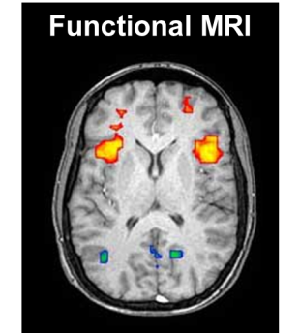
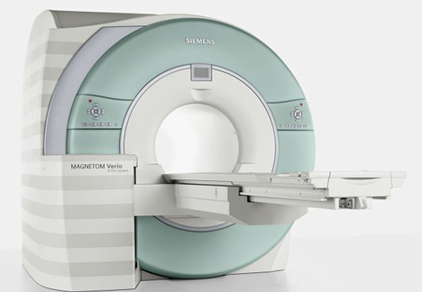
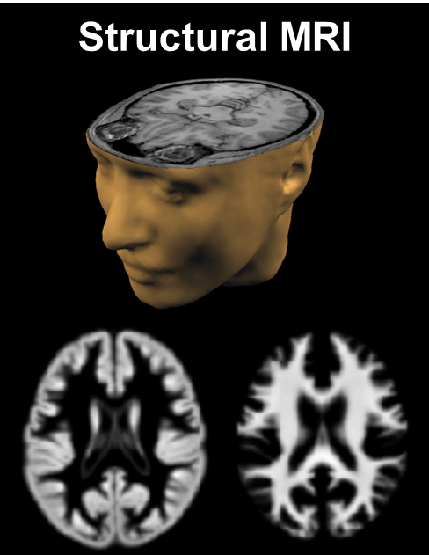
How the brain is studied
MRI: Structural and Functional
Structural looks at brain’s structure and composition
Functional – looks at brain’s activation during various tasks
Notes:
One of the reasons little used to be known is because it used to be very difficult to study the living human brain. But new technologies like MRI (magnetic resonance imaging) can look inside the healthy brain of people of all ages, without even touching them!
An MRI scan works by using an extremely powerful magnetic field to create a 3D image of the brain. Structural MRI can be used to look at the brain’s structure –like taking an X-ray of the brain, whereas functional MRI can be used to see which parts of the brain are active during particular types of behaviour and thinking.

Slide 8
Video Animation Link

Slide 9
LINK
Video animation for SECONDARY STUDENTS
https://vimeo.com/357326797
Video animation for PRIMARY STUDENTS
https://vimeo.com/357326470

Slide 10
Brain development: from childhood to adolescence

Slide 11
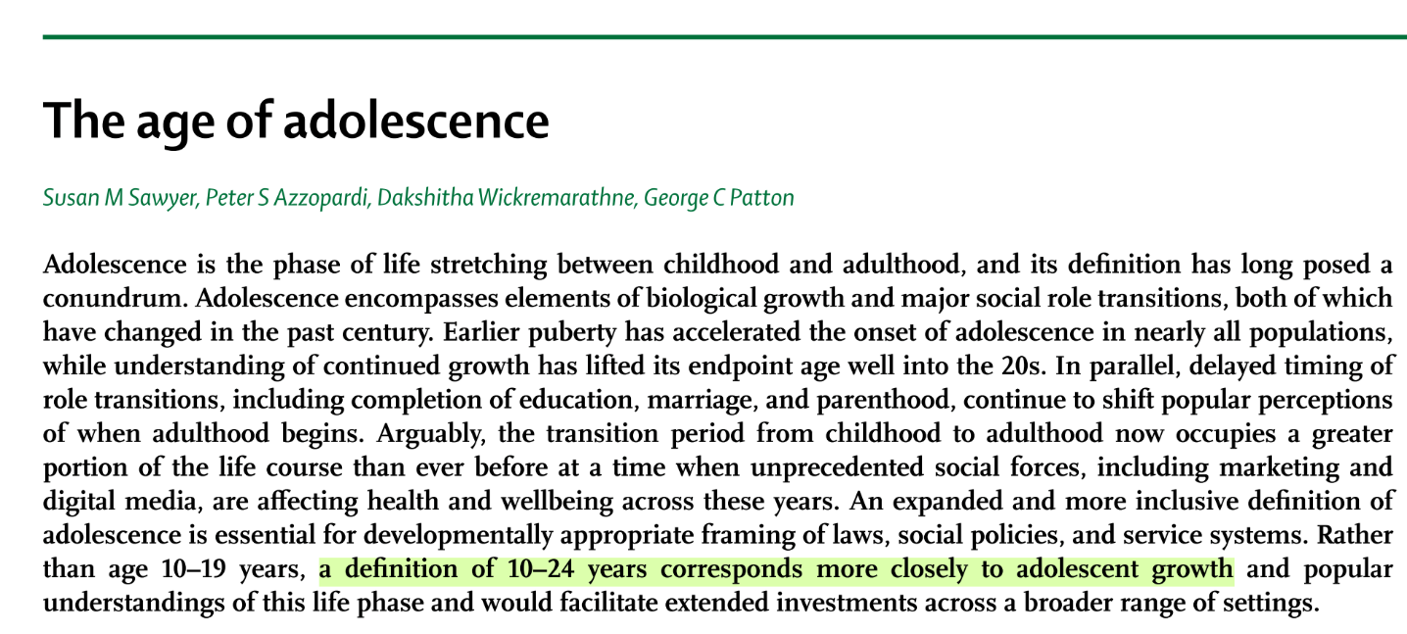
What is Adolescence?
Adolescence…
“… is a period of physical, psychological and social transition between childhood and adulthood” (Spear, 2000)
…“begins with the onset of puberty and ends with the assumption of a stable adult role” (Damon, 2004)
Podcast by Sarah Jayne Blakemore, author of Inventing Ourselves: The Secret Life of the Teenage Brain
https://www.theguardian.com/science/audio/2018/mar/23/inside-the-secret-life-of-the-teenage-brain-science-weekly-podcast
Notes:
So what is adolescence anyway? Adolescence is often defined as the period of life between the start of puberty and the reaching of an adult role in society, something which can vary according to social and cultural factors. Its not a new concept – but has actually long been recognised as a unique period in life and a time of important transitions – even in the writings of Shakespeare and Aristotle!

Slide 12
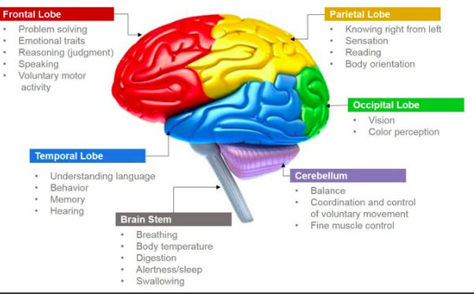
What is the brain made up of?
Different parts of the brain
Notes:
So this is what your brain looks at from the side. The outer layer is called the cortex, and is split into 4 different parts, called ‘lobes’ - shown here in red, blue, green and yellow. Different parts of the cortex are involved in different types of behaviours and thought processes. The cortex has many different folds as you can see, this makes the surface area of the brain bigger, which means it can process lots of information. Underneath the cortex is called the sub-cortical or ‘deep brain’ – and this is where lots of important regions are –including the limbic system.

Slide 13
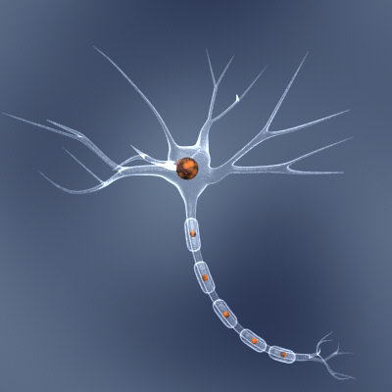
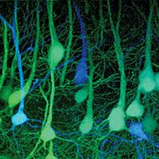
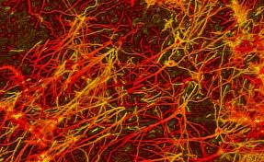
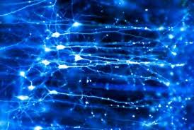
Brain structure
Neurons and Networks
Dendrites
Cell Body
Axon
When a neuron is activated it fires an electrical impulse
Notes:
To understand what MRI can show us - helps to know a bit about the structure of brain. If you look at the brain under a microscope you will see that it is mainly made up of cells called neurons. Neurons consist of a cell body, spindly projections called dendrites, and a long cable called an axon.
When a neuron is activated, an electrical impulse is fired down length of axon, carrying signal to different parts of brain. Axons can be extremely long. For example, in humans, some sensory neurons run whole length of body and have axons up to 1.5m in length.

Slide 14
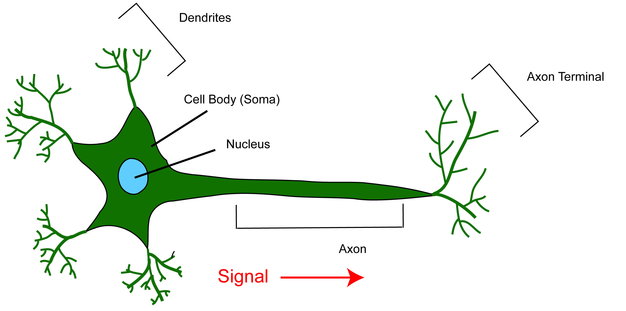
Neurons and networks
The human brain contains:
~100 billion neurons
~1 million billion connections
The structure of a neuron:

Slide 15
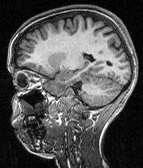
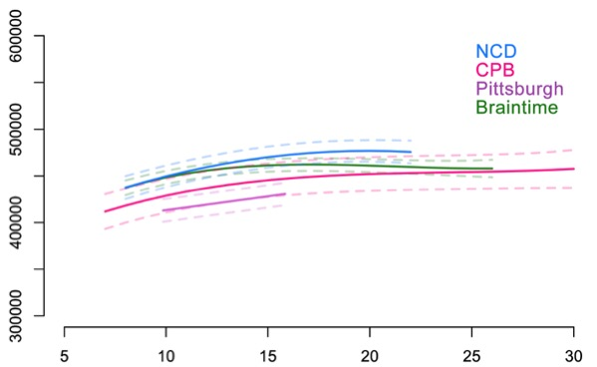
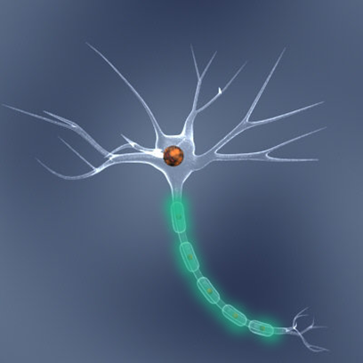
Cortical White Matter Volume - Increases
White matter is made up of the long nerve fibres that connect cells and carry signals between brain regions, and their myelin sheaths (which insulates the nerves)
These myelin sheaths are what make white matter look white in a brain scan!
White matter volume increases up to 1% annually during adolescence
White Matter
Long fibres that carry signals
between brain regions
Mills et al. (2016) Neuroimage
Cerebral white matter volume
Cortical white matter volume
age
Age
Notes:
Neuroscientists have used structural MRI to take brain scans of loads of people of different ages to track changes in the structure of the brain as we get older. These studies have shown that even though the overall size of the brain doesn’t change much during adolescence, there are lots of big changes happening to the amount of different types of brain tissues. This graph shows that during adolescence white matter volume keeps increasing, all the way into the 20s. Because white matter is made up of the parts of brain cells that connect different parts of the brain, this increase means that communication between different parts of the brain gets faster and more efficient. One of the reasons white matter increases is because as we get older we make more and more myelin, which insulates the axon cables and speeds up the electrical signals!

Slide 16
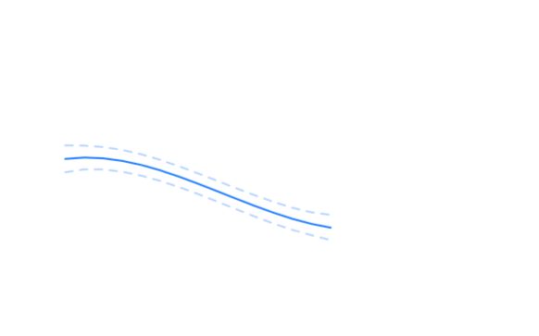
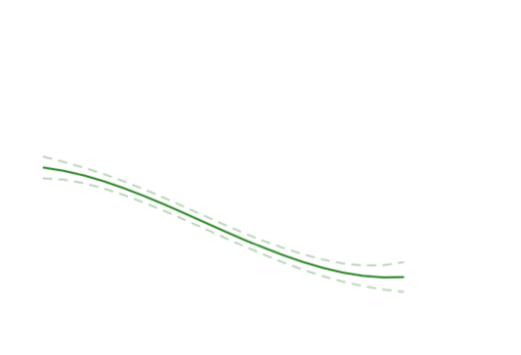
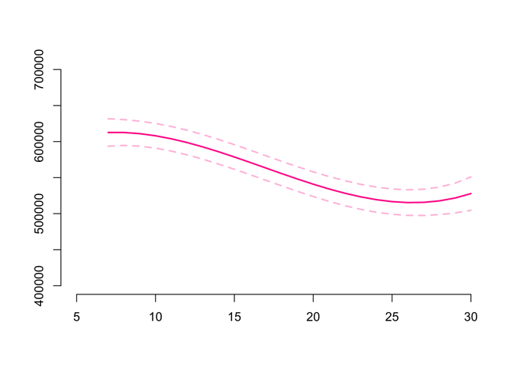
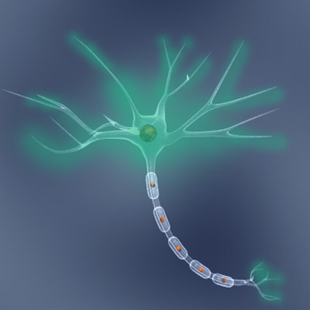
Cortical Grey Matter - Decreases
Grey matter is made up of the cell bodies and connections (synapses) and is the darker tissue of the brain and spinal cord
Grey matter volume decreases around 1.5% annually during adolescence
Grey Matter
Neurons and connections
Mills et al. (2016) Neuroimage
Cortical grey matter volume
Cortical grey matter volume
age
Age
age
Notes:
Neuroscientists have used structural MRI to take brain scans of loads of people of different ages to track changes in the structure of the brain as we get older. This graph shows that as we get older, the amount of grey matter we have, decreases. This starts in childhood and carries on all the way through adolescence and into our 20s! Now it might sound bad that something is decreasing, but its really not! Scientists think that one reason for these changes is because of changes in the number of connections between brain cells.

Slide 17
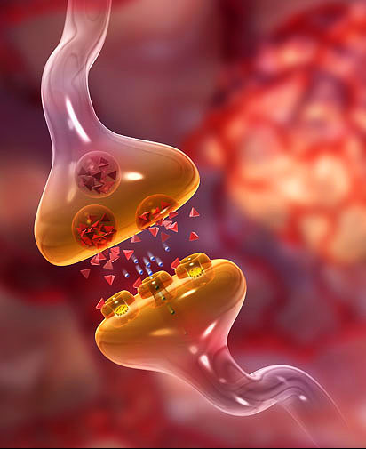
Synapses - Decrease
The synapse is the contact point between neurons
The electric signal is converted into a chemical signal called a neurotransmitter
This creates networks of connected neurons
This is the ‘language’ of the brain
Synapses are decreased during adolescence
Notes:
Neurons don’t work by themselves - they connect together into intricate networks, and these networks are how the brain does everything it does – a bit like a computer. The point at which two neurons connect with each other is called a synapse. At these connections the signal from one neuron is passed onto another neuron, and is changed from an electrical signal into a chemical signal, and then back to an electrical one again. Different types of neurotransmitters like serotonin and dopamine can also change the flow of signals, which is why they affect many different things, like how we feel, behave and think! Most drugs affect our neurotransmitters, which is how they affect our brains and behaviour.

Slide 18
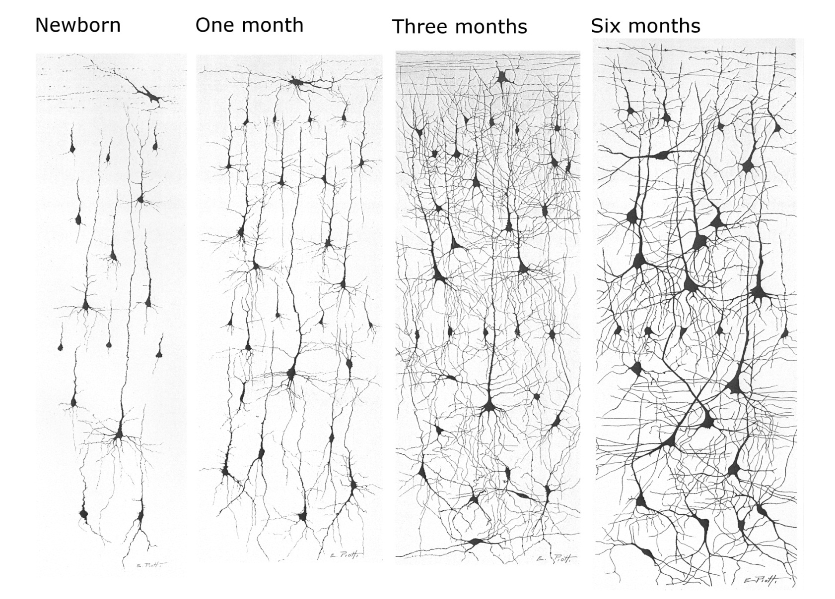
Synaptic Pruning
Notes:
From the moment we are born, the number of synapses between neurons starts to increase drastically, although the number of neurons themselves remains roughly the same. These pictures, show neurons and their connections – black dots are the cell bodies. In first 6 months of life, the number of connections keeps increasing, a process known as synaptic growth that continues for several years. In most brain regions this results in too many synapses, many more than is found in a fully developed brain.

Slide 19
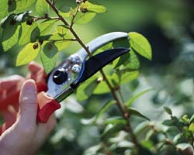
Synaptic Pruning
Why?
Synapses are pruned to make brain networks more efficient
How?
Synapses that are used are strengthened
Synapses that are not used are pruned away
The Result
The brain becomes more specialised to our environment but less plastic and adaptable
Notes:
The excess synapses need to be eliminated, because there isn’t room to keep all of them, and have them grow and become stronger and faster. This happens by a process known as pruning, which means the connections that are being used are strengthened, and those that are not die off. It’s a bit like pruning a rose bush – weaker branches are pruned away to allow the remaining branches to grow stronger. This is a really clever process. It means that the infant brain is equipped with the resources to deal with any environment – but then it fine-tunes itself to the particular environment it finds itself in.

Slide 20
Synaptic Pruning in Action: Speech Sounds
An example highlighting a sensitive period of development and how the environment can radically shape developing brain.
Adapted from Kuhl 1998
Notes:
Nice example in language context. Native adult speakers of Japanese have difficulty hearing the difference between ra and la – the distinction does not occur within the Japanese language. However, at 6-8 months both English & Japanese infants can easily tell the difference. Yet, by 1 Japanese infants no longer differentiate -the distinction is not needed for language comprehension in their specific environment and so the brain eliminates the connections involved. Also speech sounds that native English speakers can’t hear a difference between is because they weren’t exposed to them in early life.

Slide 21
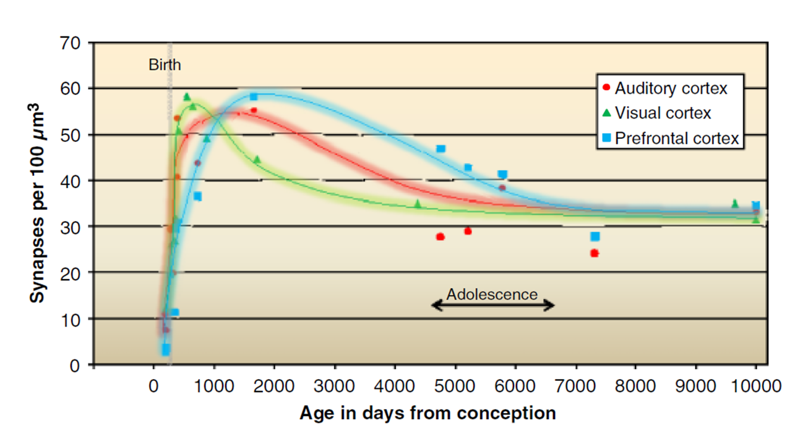
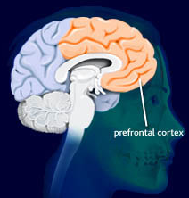
Synaptic Pruning
Synaptic Pruning
Different parts of the brain develop at different times and at different speeds
Synaptic pruning
in prefrontal cortex continues during adolescence
Data from Huttenlocher & Dabholkar (1997), replotted in Thomas & Johnson (2008)
Notes:
Different parts of the brain develop at different times and at different speeds. This graph shows changes in number of synapses in different brain areas at different ages from birth. All brain areas shown show similar pattern of change in number of connections - initially an increase as more synapses develop, then a decrease as they get pruned away. The earliest area to develop is the visual cortex, which is located at the very back on the brain – in the occipital cortex. Our auditory cortex is involved in hearing, and this also develops quite early, like the example of the ra/la sounds in language. However, some areas develop much more slowly and later on. One of the latest areas to develop is the prefrontal cortex – the ‘front brain’, in which synaptic pruning continues throughout adolescence and into the 20s.

Slide 22
Continuum of brain development from childhood to adolescence
Different profiles of development for different abilities
Age
Attention and self-regulation
Motor skills e.g. walking
Vision
Social & emotional processing
Planning and decision making
Speech &
language
Many skills are plastic and developing into adolescence / young adulthood!
Notes:
These changes mean that different types of behaviours and cognition are more plastic at different times in life, which means that at that time its important to be in an environment that stimulates that kind of learning. For example, when we are very young, its really important to have good visual stimulation, so that our ability to see things clearly develops. This is why a lot of toys for babies are designed to be colourful and visually interesting, to help develop these skills. As we get older, different skills develop at different time, depending on the brain regions involved and when they develop. One of the key changes that happens to the brain in adolescence, is that whole brain becomes more integrated, which means complicated skills that use many different brain areas at the same time become more efficient and we can do more things at once.

Slide 23
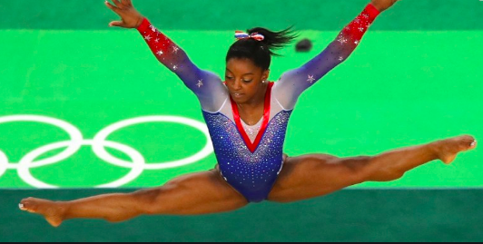
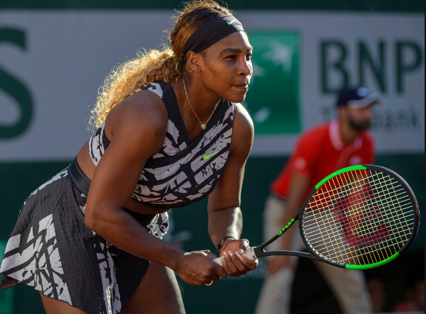
Practical examples of students who took advantage of their brain’s plasticity!
Athletes
Messi and Ronaldo both started playing
football at 8 years old
Simone Biles was just 6 years old when she took up gymnastics
Serena Williams was only 3 years old when she picked up a racket!

Slide 24
Musicians
Justin Bieber started making videos of himself singing at 12 years old
Ed Sheeran decided to pursue his music career at 14 years old when he started busking in London.
Taylor Swift had released her first debut album at 16 years old.

Slide 25
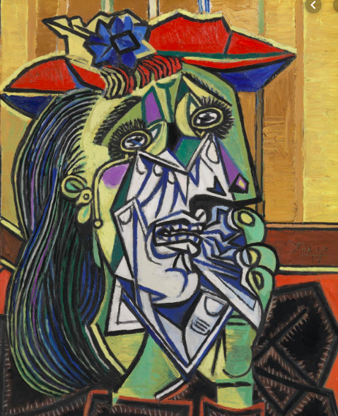
Artists and Authors
Picasso started figure drawing and oil painting lessons at 7 years old
JK Rowling wrote her first 'book’ at 6 years old

Slide 26
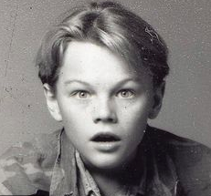
Actors and Actresses
Leonardo DiCaprio was acting on TV shows when he was just 5 years old
Emma Watson started in Harry Potter at 11 years old

Slide 27
Adolescent Brain Development - A Summary
The brain continues to develop long into adolescence and even into early adulthood
Prefrontal regions continue to develop most substantially during adolescence
There is a significant reduction in grey matter volume and a significant increase in white matter volume and connections between neurons that are used a lot strengthen
This means adolescence is a great time to learn and develop new and existing skills as the brain is malleable and able to learn quickly!

Slide 28
Cognitive Development

Slide 29
Social Cognition
The human brain is hardwired to understand people, and to think about mental states, emotions, beliefs and intentions.
When you think about many things you are engaging your social brain. Because the pre-frontal cortex continues to develop until the early to mid 20’s, we’re interested in seeing if and how social cognition changes in childhood and adolescence.
Therefore scientists design experimental tasks to study social cognition in people of all ages.
Here is an introduction to Social Cognition by Professor Frith:
https://www.youtube.com/watch?v=k2LCoa6RhOY

Slide 30
The Social Brain – An Experiment
When you show this animation to people, they almost always make up a social story about it. For example a mother triangle is trying to encourage its baby triangle to leave the safety of their home, and is nudging it out, even though at first it’s a bit scared, and then at the end is proud! This is despite the fact that they are only very simple line drawings!
Link to animation: https://youtu.be/9Tt7aqHFUCU

Slide 31
Social Cognition – some types emerge early in childhood
Helping behaviours in 18-month-olds
https://www.youtube.com/watch?v=kfGAen6QiUE
Warneken &Tomasello , Science 2006
Notes:
Some types emerge early in childhood
Look at what little toddler does when he sees the man struggling to open the door…..

Slide 32
Mentalising Understanding that different people think different things
For some time now, scientists have been coming up with tasks that can be used to measure social cognition, particularly mentalising, which is the ability to understand that other people can think, feel and believe different things to us.
Probably the oldest and most well-known task that looks at this ability experimentally is called the Sally-Ann task, which can be used to assess mentalising in very young children

Slide 33
The Sally Anne Test – Part 1
Link of children doing this test:
https://www.youtube.com/watch?v=oazK2fkRU1A
Baron-Cohen, Leslie and Frith (1985)

Slide 34
The Sally Anne Test – Part 2
Now this is quite an easy task, children are able to correctly answer this by the age of around 4 or 5, but the social brain doesn’t stop developing at this point!

Slide 35
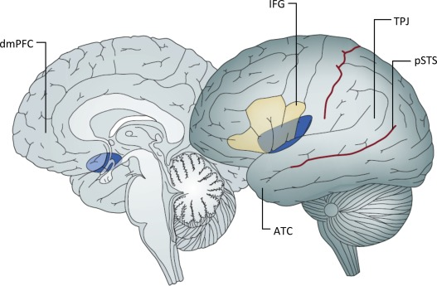
The Social Brain
The social brain network includes the prefrontal cortex which continues to develop until the mid twenties!
Prefrontal cortex
To see whether the development of the prefrontal cortex relates to changes in social cognition in adolescents, scientists have been designing more difficult experimental tasks that that can be used to study more complicated parts of social cognition like this one:
The Social Brain Network
Kilford et al (2016) Neuroscience & Biobehavioural Reviews
Imagine you’re the woman and the man says:
‘move the large ball up’
Which is the correct ball to move?
Notes:
This task is called the director task, and its much harder than the Sally Ann task. Adults get about half of the questions wrong! Here, the correct answer is the football, because the man can’t see the basketball! Performance on this task results in activation in the social brain network and continues to improve all the way through adolescence

Slide 36
What else is happening to the brain during adolescence?

Slide 37
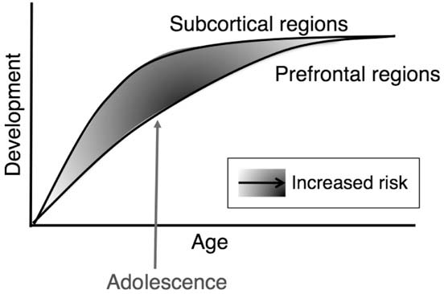
Dual Systems Theory: The Prefrontal Cortex and Limbic System
When we’re making decisions, we use two different brain systems. System 1 is our intuition or gut-feeling: fast, automatic, emotional – referred to as LIMBIC in diagram below. System 2 is slower and more deliberate: consciously working through different considerations, applying different concepts and models and weighing them all up – referred to as PREFRONTAL CORTEX below:
Limbic regions
Prefrontal cortex
Limbic regions
Emotions
Reward
Risk-Taking
Prefrontal Cortex
Regulation
Planning
Decision-Making
Casey, 2008; Steinberg, 2008
Notes:
When we’re making decisions, we use two different systems of thinking. System 1 is our intuition or gut-feeling: fast, automatic, emotional, and subconscious. System 2 is slower and more deliberate: consciously working through different considerations, applying different concepts and models and weighing them all up. Even though brain development is different for everyone, on average the pre-frontal cortex develops later than the limbic system, which develops a lot when we reach puberty.

Slide 38
And what is the impact on thoughts, feelings and behaviour?

Slide 39
Risk
Scientists have suggested that maybe the earlier development of the limbic system than the prefrontal cortex could be a reason why adolescence is a time people often associate with taking riskier choices, and changes in our mood and emotions

Slide 40
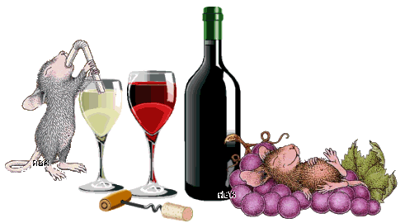
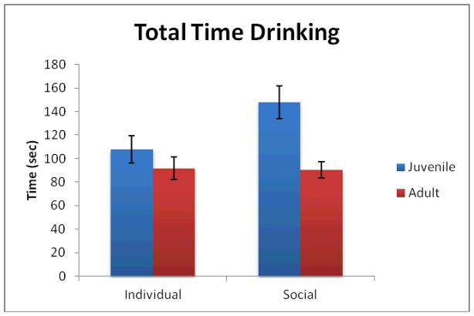
The Risky Adolescent Mouse!
Adolescents are more likely to engage in risky behaviours when they are with their friends and this is also true with mice
Adolescent (but not adult) mice drink more alcohol when with other mice!
Logue et al. (2014)
Notes:
Social factors are also a key part of adolescent typical behaviours. Adolescents are more likely to engage in risky behaviour when they are with their peers – and this is even the case for mice

Slide 41
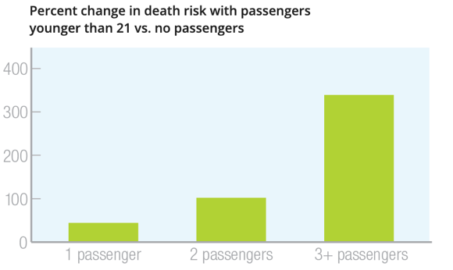
Adolescent risk taking in driving context
Three groups:
Adolescents (13-16y)
Young adults (17-24)
Adults (25-40)
https://www.youtube.com/watch?v=rt9MyNo65eI
Gardner & Steinberg (2005)
Percentage increase in death risk according to no. of passengers for drivers under 21 years
(AAA Foundation, 2017)
Notes:
To study risk-taking in humans, scientists use a driving game. In the game your goal is to get round the course as quickly as possible. If you reach traffic lights that are amber, you have to choose whether to stop and wait for the light to go green, or run the light. If you run the light, you might make it through meaning you’ll be faster – but you also might crash which will take points off your overall time score. When people of different ages play this game alone, there is not difference in the number of risks people take. However, when people play it while their friends watch it’s a very different story! 13-16 year olds take over 3x as many risks, whereas adults don’t change the amount of risks they take at all. Young adults are half way in between – this is probably why car insurance is more expensive for under 24 year olds! Sadly, this is also what we see in real life data – the risk of serious accidents increases according to the number of passengers for young drivers – whereas adults show the opposite – they are most likely to have an accident when they are alone.

Slide 42
Why do adolescents take more risks in front of friends?
There is no ‘average’ adolescent! And so the answer is likely complicated and different for different people. But here some theories:
1. An increase in reward sensitivity
Limbic regions
As we get older, the limbic system – the part of the brain involved in seeking rewards and feeling good becomes more active
Adolescents will experience varying differences between their limbic regions and prefrontal cortexes during their adolescence, but on average the brain is likely to be more sensitive to getting rewards at this time of life
Such a range is completely normal and will also be impacted by life events and environmental influences

Slide 43
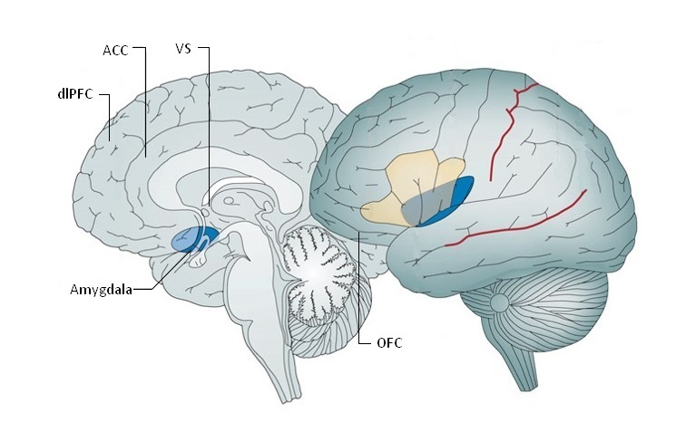
Increased Reward Sensitivity
Adolescents have an increased sensitivity to rewards, and feel more excited than adults as result of thrill seeking behavior (there is more activation in the reward-related regions of their brains).
Importantly, this is seems to increase when they are with their friends.
Ventral striatum
Orbitofrontal cortex
Chein et al 2011, Developmental Science
Notes:
Scientists have also used fMRI to look at what happens to brain activity during the driving game. People play the game while they are inside the scanner, either with or without their friends watching. Studies like this have found increased activation in reward regions of the brain – including the ventral striatum which is a key part of the limbic system. People of all ages show activity in reward regions of the brain when they take a risk and don’t crash, but this is greatly increased in adolescents when they are being watched by their friends, whereas adults don’t show a change according to their social context.

Slide 44
Why do adolescents take more risks in front of friends?
2. Social influence changes our risk perception
In adolescence, people our own age become really important. This is an adaptive process called social re-orientation. Since social cognition and social processing develop during this time, it makes sense to give the brain as much social input as possible so that we can develop these skills.

Slide 45
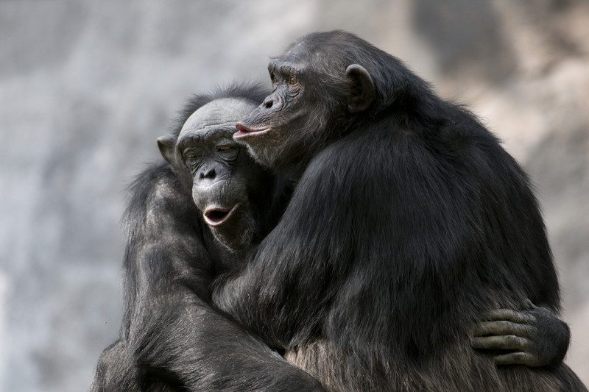
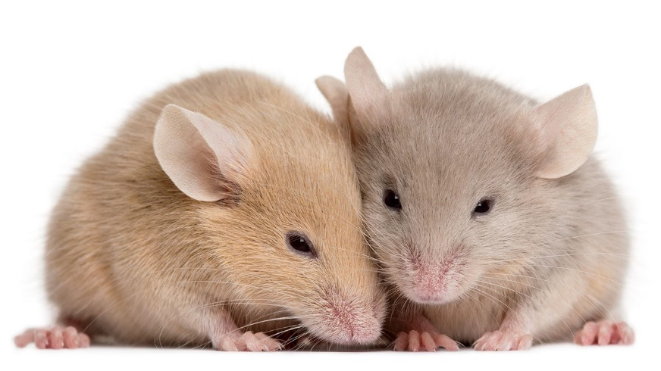
A Period of Social Re-Orientation
Adolescents begin to spend more time with their friends than their parents, compared to children.
There is significant evidence for social re-orientation between childhood and adolescence in other species too:
Adolescent chimpanzees and mice show a similar pattern of behaviour show increased social engagement during this period of life

Slide 46
Social Influence on Risk Perception
Rating 1
Adults rated
Teenagers rated
crossing a street on a red light
crossing a street on a red light
crossing a street on a red light
crossing a street on a red light
How risky is this behaviour?
Knoll et al (2015)
Low
risk
High risk
Low
risk
High risk
Notes:
Scientist have used experiments like this to investigate whether adolescents are more influenced by what other adults think, or what other teenagers think when they are deciding how risky different things are. People see a risky situation like crossing a street on a red light on a computer screen and rate how risky it is. Then they are shown either how other adults rated it, or how other teenagers rated it. Later on they re-rate the situation. If people change their rating more towards the rating of other people, then they have been socially influenced.

Slide 47
Why do adolescents take more risks in front of friends?
3. Heightened fears of social exclusion
The increased importance of social factors during social re-orientation can also result in increases in fears of social exclusion, the effects of exclusion on our wellbeing and the way that the brain processes feeling excluded.
Scientists have used a game called Cyberball to study the effects of social exclusion on cognition, emotions and the brain at different ages:
https://www.youtube.com/watch?v=OwQ_VyOUGmY

Slide 48
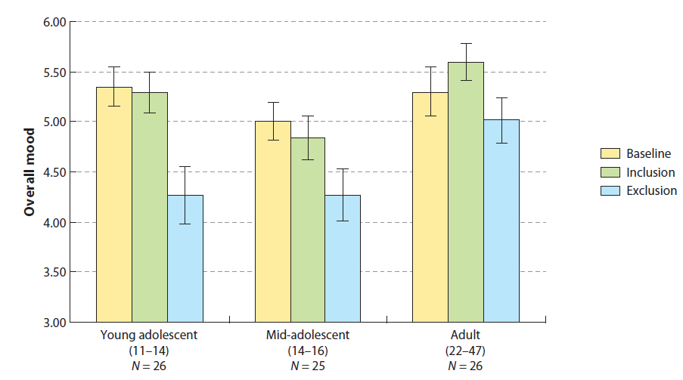
Fear of Social Exclusion
Adolescents are hypersensitive to social exclusion
Sebastian et al., Brain & Cogn (2010)
Notes:
There are 3 different parts to the game. Baseline is the start of the game. Then people are included by the other players (inclusion phase)d and then excluded (exclusion phase). This graph shows how being excluded in Cyberball at different ages affects our mood. People of all ages show a drop in mood after being socially excluded in the game. However, this was greater in adolescents than adults, particularly in younger adolescents.

Slide 49
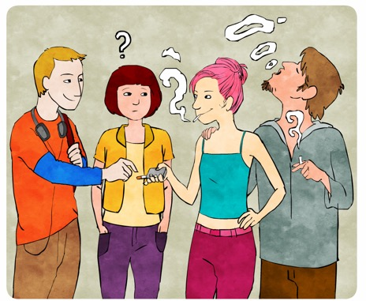
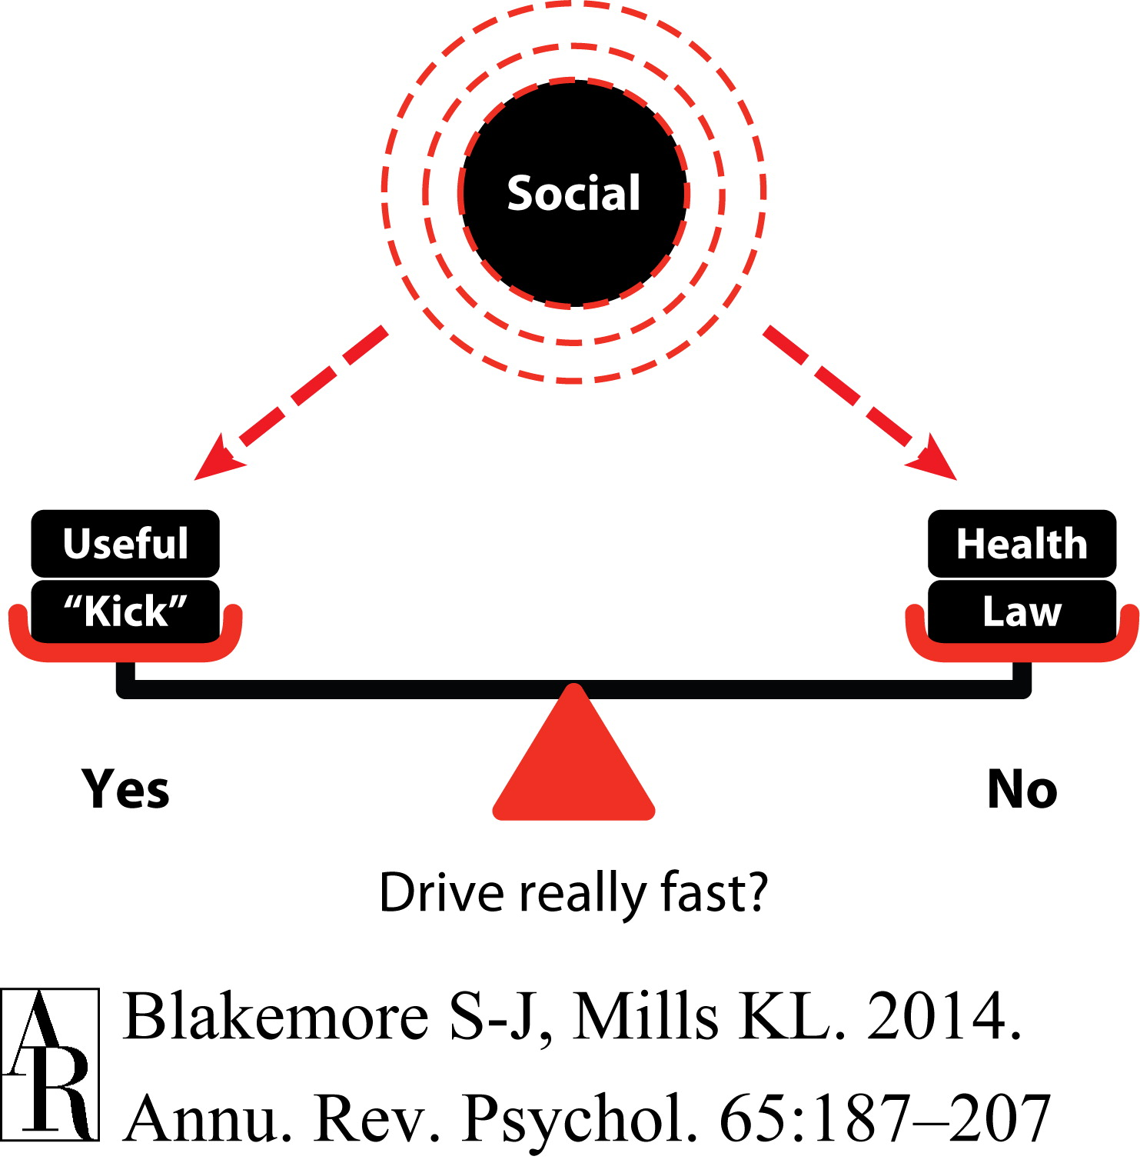
Why do adolescents take more risks in front of friends?
4. Avoiding social risk might matter more to adolescents than avoiding physical risk or harm when weighing up the outcomes of a decision due to the importance of social factors at this age
For example the health risks of smoking, or legal risks of driving really fast may matter less than the risk that being excluded by our peers might have on our wellbeing
https://www.youtube.com/watch?v=zwQDxn0SA44&feature=youtu.be
Blakemore (2018) Current Directions in Psych Science
Blakemore & Mills (2014) Annual Review of Psychology
Notes:
Illustration of some of the factors that influence certain risky decisions. In a scenario in which the individual is making a choice whether or not to drive very fast, multiple factors will weigh in, such as the potential outcome of injury (health), being arrested (law), arriving somewhere in less time (useful), and getting a subjective feeling of pleasure from the experience (“kick”). Above this “seesaw” is another potential factor that could weigh on either side of the decision process, which is made up of social factors (e.g., family, teachers, peers). The potential of peer acceptance/rejection could weigh on either side of the seesaw depending on the peers, and the weight of the factor (indicated by dashed lines) will vary on the basis of the individual and their age.

Slide 50
Summary of impact of adolescent brain development on thoughts, feelings & behaviour
Increased reward sensitivity
Social re-orientation leading to social influences changing risk perception
Heightened fear of social exclusion
Avoiding social risk being prioritized over avoiding physical risk

Slide 51
Adolescence: A Time of Opportunity…
Many of the behavioural and cognitive changes in adolescence assist the transition to an independent adult role
Taking risks increases exploration, innovation, learning and creativity.
Social changes facilitate new relationships, increased intimacy and mature self-awareness

Slide 52
Lesson Activity Suggestions

Slide 53
Lesson Activity Suggestions for Primary Aged Students (all regions)
Activity/Resource & Link | Description
A series of experiments to assess if you are right or left side dominant from web based resource -Neuroscience for kids: https://faculty.washington.edu/chudler/rightl.html | Tests for hands, feet, sight and hearing. Full instructions for teacher, downloadable worksheets Results can be compared between class members
Synaptic Tag https://faculty.washington.edu/chudler/outside.html | A practical game to play outside to reinforce the information on synapses covered in slide 14-19
To experience the marshmallow experiment and understand the concept of ‘Instant Gratification’.(or a simplified explanation might include terms like ‘immediate pleasure or putting the treat or nice thing off until later’) https://www.youtube.com/watch?v=QX_oy9614HQ | Students to try the marshmallow experiment and record their findings. Watch the marshmallow experiment and try to explain why it’s hard not to eat the marshmallow straight away. Ask students if there are other things or certain circumstances that that may make it hard to resist temptation – e.g. watching tv instead of doing homework Ask students when ability to put off treats or nice things might be a good thing

Slide 54
Lesson Activity Suggestions for Primary Aged Students (all regions)
Activity/Resource & Link | Description
Frontiers for Young Minds-https://kids.frontiersin.org/article/10.3389/frym.2016.00016 | Students to read article on 'Emotions and the Brain – Or How to Master “The Force” ‘ and use to explain verbally or on paper how MRI scanning works. Appealing resource for younger children linking emotions to star wars
Exploring emotions using the Disney film – ‘Inside Out’ as stimulus. Brief summary of film: After young Riley is uprooted from her Midwest life and moved to San Francisco, her emotions - Joy, Fear, Anger, Disgust and Sadness - conflict on how best to navigate a new city, house, and school. Trailer clip: https://www.youtube.com/watch?v=_MC3XuMvsDI | There are many things one could do with this film apart from watch it of course! Other tasks might include: Discuss how what is happening in the brain might manifest itself in real life behavior – e.g. when a child is sleepy, do they always recognise this and ask to go to bed? Asking students to draw a picture of the brain (slide 12) and linking it to their emotions, which they could personify in a similar way to the film. Asking students to remember key memories from their time at school and what impact they might have on their feelings or behaviours today. Please note that it may be better to stay away from childhood memories in general in this context to avoid raising sensitive issues.

Slide 55
Lesson Activity Suggestions for (older) Primary & Secondary Aged Students (all regions)
Activity/Resource & Link | Description
Experiment – The Stroop Effect.. Students could either watch or do this experiment http://brainu.org/lesson/do-stroop | This phenomenon is nicknamed the ‘Stroop effect’ Simply put, the Stroop effect shows how the brain processes words and colours differently and the resources contain a video link and teacher instruction for those wishing to do the experiment with a class
Design own experiment to measure social cognition | Students to watch the social cognition experiments and design their own. (Slides 29– 35) They could test these out with other groups. They should make note of the age range and expected result They could animate it (in same style as Sally Anne) or write it out or act it out Teacher involvement and assistance could be moderated by age

Slide 56
Lesson Activity Suggestions for Senior Aged Students (all regions)
Activity/Resource & Link | Description & Age Recommendation
To experience the marshmallow experiment and understand the concept of ‘Instant Gratification’. Slides – 42 & 43 https://www.youtube.com/watch?v=QX_oy9614HQ The Marshmallow Test and Why We Want Instant Gratification: Silvia Barcellos at TEDxMidAtlantic 2012 https://www.youtube.com/watch?v=voF8B-Jr0mA https://behavioralscientist.org/try-to-resist-misinterpreting-the-marshmallow-test/ | Students to try the marshmallow experiment and record their findings. Watch the marshmallow experiment and try to explain the concept of instant gratification. Ask students if there are other temptations or certain circumstances that that may make their resolve weaker. For older students, link to peer pressure and neuroscientific reasons behind this pressure This video is suitable for senior students and makes relationship between ability to delay instant gratification (self-control), the impact of the environment and future success to broaden discussion This is an excellent article which questions the validity of the marshmallow test and highlights the importance of environmental factors in influencing positive or negative outcomes

Slide 57
Lesson Activity Suggestions for Senior Aged Students (all regions)
Title and link | Description & Age/Region recommendation
Life lessons from a brain surgeon – Dr Rahul Jandial (Book) https://www.amazon.co.uk/Life-Lessons-Brain-Surgeon-healthier-ebook/dp/B07GRDH1KJ Trained neurosurgeon and scientist at City of Hope, a research centre, hospital and postgraduate training faculty in Los Angeles. When he isn’t performing surgery he is leading a team of scientists in Jandial Laboratory, named after him and known for its cutting –edge approach to brain surgery and neuroscience. Excerpt: By the time Rahul Jandial saw Jennifer she was sedated and he was her last hope. The six-year-old girl’s epilepsy had advanced to the point where, if left untreated, the continuous seizures erupting randomly from across the right hemisphere of her brain would start to inflict lasting neurological damage. However, the symptoms were so severe that controlling them with medication would mean condemning her to life in an unconscious state. The only possible solution, the surgeon told her desperate parents, was to cut out half of their daughter’s brain’ | ‘A great book for budding medics or psychologists. Notable chapters include content on how brain can heal itself, head injuries (relevant to contact sports enthusiasts) and how creativity develops in the brain. There are also tips on how to maximise your brain’s capacity. * Note the chapter on his views on ‘smart drugs/stupid drugs’ that may be controversial and should be checked before sharing book as a whole.

Slide 58
Lesson Activity Suggestions for Senior Aged Students (all regions)
Activity/Resource & Link | Description
Exploring emotions using the Disney film – ‘Inside Out’ as stimulus. Brief summary of film: After young Riley is uprooted from her Midwest life and moved to San Francisco, her emotions - Joy, Fear, Anger, Disgust and Sadness - conflict on how best to navigate a new city, house, and school. Trailer: https://www.youtube.com/watch?v=_MC3XuMvsDI Clip 1: https://zuckermaninstitute.columbia.edu/what-film-inside-out-can-teach-us-about-brain-mind-and-ourselves Clip 2: https://www.blakeporterneuro.com/inside-outs-take-on-the-brain-a-neuroscientists-perspective/ | The film focuses on how Riley’s memories generate feelings of: Joy Fear Surprise Sadness Disgust Anger Clip 1 looks at the role of the hippocampus/memory formation in this film and might be interesting for senior aged students/those studying psychology: Clip 2 is a video interview the two scientists who were part of a group the filmmakers consulted with while making the film. Drs. Shadlen and Shohamy describe what the film means to them as scientists, as teachers and even as parents.

Slide 59
Lesson Activity Suggestions for Senior Aged Students (all regions)
Title and link | Description & Age/Region recommendation
Risk Taking Question – ‘Why is 72% of adolescent mortality due to 4 preventable causes?’. Discuss and present findings either as a verbal or written presentation Slides 39 - 51 | In pairs or groups, students to guess what the 4 causes are and how adolescent brain development might explain this, as well as how they might as individuals and friends minimize these risks (Risks could be suggested depending on age of student – e.g. driving related to older students)
Developments in Neuroscience - Comprehension Slides 12 & 37 https://www.thevintagenews.com/2017/02/25/the-bizarre-story-of-how-a-railroad-worker-survived-an-iron-rod-which-went-through-his-skull/ | Students to read the resource and explain why the damaged region of Phineas Gage’s brain impacted his behavior in such a way and how this injury better helped our understanding neuroscience.
A series of experiments to assess if you are right or left side dominant from web based resource -Neuroscience for kids: https://faculty.washington.edu/chudler/rightl.html | Tests for hands, feet, sight and hearing. Full instructions for teacher, downloadable worksheets Results can be compared between class members
Understanding impact of concussion on the brain Notes in slides 60-61 (next) | Reading the resource clip, prepare an argument for or against the topic: ‘Rugby/Heading the ball in Soccer, should be banned as a school sport’

Slide 60
Concussion - Resources to Support Activity
1. A straightforward explanation about concussion in bullet point form, along with tips to avoid and treat it: https://www.brainline.org/article/concussion-and-sports
2. This resource contains a video explanation of concussion, as well as an outline of how it might impact students at school and what to do in the case of a concussion : https://kidshealth.org/en/teens/school-concussions.html?WT.ac=t-ra#catstaying-fit
3. The other side of the argument – is lack of participation in sport more of a risk to students than concussion? https://www.youtube.com/watch?v=Z42suyFJZKk
Have the precautions gone too far in cricket? https://www.northerndailyleader.com.au/story/6337277/ca-caution-against-concussion-overreaction/?cs=2438
4. Consensus statement on concussion in sport—the 5th international conference on concussion in sport held in Berlin, October 2016. This resource is suitable for students aged16-18: https://bjsm.bmj.com/content/51/11/838
5. Soccer has the highest rate of concussions among female athletes compared to any sport. In fact, concussions now account for more injuries in girls’ soccer than boys’ football: https://completeconcussions.com/2017/06/05/5-truths-concussions-soccer/
6. A couple of news links about concussion in rugby:
https://www.bbc.co.uk/sport/rugby-union/43802462
https://www.bbc.co.uk/sport/rugby-league/42946815

Slide 61
Resources

Slide 62
Resources Part 1
Resource Title and link | Description & Age Recommendation
Frontiers is a leading Open Access Publisher and Open Science Platform: https://kids.frontiersin.org/article/10.3389/frym.2016.00016 | A platform where students can engage with leading scientists in reviewing and editing cutting-edge research Suitable for primary and senior aged students as well as staff/parents
Centre for the Developing Adolescence - http://developingadolescent.org/research-application/adolescent-development | Web based resource that aims to to improve adolescent health, education, and well-being through developmental science. Suitable for all students
BrainFacts.org – Web based resource and a public information initiative of The Kavli Foundation, the Gatsby Charitable Foundation, and the Society for Neuroscience https://www.brainfacts.org/ | A global nonprofit organizations dedicated to advancing brain research. Powered by the global neuroscience community and overseen by an editorial board of leading neuroscientists from around the world, BrainFacts.org shares the stories of scientific discovery and the knowledge they reveal. Unraveling the mysteries of the brain has the potential to impact every aspect of human experience and civilization. Suitable for all students, staff and parents

Slide 63
Resources Part 2
Resource Title and link | Description & Age Recommendation
You are awesome - Matthew Syed (book) https://www.youareawesomebook.co.uk/ | A positive and empowering guide to help children build resilience, fulfil their potential and become successful, happy, awesome adults. It highlights the malleability of the young brain and dismisses the notion that you need a certain ‘type of brain’ to be good at Maths. Suitable for students aged 9-14
The Whole Brain Child (book) Dan Siegel https://www.drdansiegel.com/books/the_whole_brain_child/ | A book for parents which explains how a child’s brain is wired, how it matures as well as giving practical parenting strategies. Suitable for parents of younger children especially and staff
The Teenage Brain (book) A Neuroscientist’s Survival Guide to Raising Adolescents and Young Adults – Frances E. Jensen https://www.harpercollins.com/9780062067869/the-teenage-brain/ | A rigorous yet accessible book which sheds light on the brains of adolescents and analyses this knowledge to share specific ways in which parents can help them navigate their way more smoothly into adulthood. Suitable for parents, staff and older students interested in psychology

Slide 64
Resources Part 3
Resource Title and link | Description & Age Recommendation
The Mentally Healthy Schools Workbook Pooky Knightsmith | This is a hands-on whole-school guide to help staff identify their school's mental health strengths and weaknesses and what can be done to improve them. Packed with helpful tips and ideas, it provides both a framework and practical steps to evaluate and support the mental health and wellbeing of all learners, and staff, and to engage parents too. Suitable for all staff
Inventing Ourselves The Secret Life of the Teenage Brain (book) - Sarah Jayne Blakemore https://www.amazon.co.uk/Inventing-Ourselves-Secret-Teenage-Brain/dp/0857523708 | Drawing upon her cutting-edge research, award-winning scientist Sarah Jayne Blakemore explains how are brains develop in adolescence, and what scientific experiments have revealed about our behavior and how we relate to each other and our environment in these years. Suitable for teachers, parents and older students
The Blakemore Lab (UCL Developmental Cognitive Neuroscience Group) - https://sites.google.com/site/blakemorelab | Online resource with more information and further studies on the brain/neuroscience. Suitable for older students/staff

