Slide 3
“The best bridge between despair and hope is a good night’s sleep" Dr Matthew Walker – Founder and Director of the Centre for Human Sleep Science

Slide 4
Contents
Sleep Education – Learning Outcomes
Summary of evidence
Dr Matthew Walker answers questions from Cognita students around the globe
Activity suggestions
Resources

Slide 5
Sleep Education
Raising the profile of sleep and increasing awareness of its impact on our wellbeing is a critical part of health education. The video interview with Matthew Walker and the accompanying activities are all designed to do this is a memorable and fun way.
Learning objectives
To understand why we need to sleep and appreciate that it is a non-negotiable part of being healthy, and indeed the foundation of health
To understand the different stages of sleep and their contribution to our wellbeing
To understand why we dream
To understand what can harm sleep and why
To recognise when sleep is not at its optimum
To know key ways of improving sleep quality and quantity

Slide 6
Key advice for getting better sleep
Sleep is the foundation of
good health
“How much sleep are you getting?” should be the first question asked if students are suffering from poor physical or mental health.

Slide 7
Summary of key research

Slide 9
Evidence Summary
Adolescent sleep is a rising global health concern
The World Health Organization recommends that during childhood and adolescence, we spend between half and a third of our time asleep, depending on our age.
However..
Two thirds of adults in all developed nations fail to obtain the recommended 8 hours of nightly sleep
85% of 14-17 year olds receive less than recommended amount of sleep per night

Slide 10
Stages of Sleep
There are different stages of sleep which have different purposes, and a typical adult goes through 5 to 6 of these cycles per night. They are:
Non-rapid eye movement (NREM), stages 1-4. Stages 3 and 4 of NREM sleep are the deep, restorative stages that are key for the immune system.
Rapid eye movement (REM), stage 5. Characterised by rapid eye movements, more dreaming and bodily movement, faster pulse and breathing rate. The REM stages are responsible for learning and memory.
.

Slide 11
Sleep Quantity Recommendations (in hours)
Age | Recommended Time
0-3 months | 14-17 hours
4-11 months | 12-15 hours
1-2 years | 11-14 hours
3-5 years | 10-13 hours
6-13 years | 9-11 hours
14-17 years | 8-10 hours
18-25 years | 7-9 hours
26-64 | 7-9 hours
65+ | 7-8 hours

Slide 12
What happens to your health when you don’t sleep for long or well enough? For primary aged students
You worry more
You feel sleepy during the day
You eat more sugary food that isn’t good for you
You don’t feel like taking part in sport or exercise as much
You are weaker in your body and more likely to catch things like a cold
You can’t concentrate as much in class
You will find the work harder to understand and remember
You are more likely to do silly things
You are less likely to be a good friend
You are more likely to get cross easily

Slide 13
Consequences of inadequate sleep on health For senior aged students
Increased risk of mental health conditions, especially anxiety
Excessive daytime sleepiness
Poor diet
Reduction in both desire to exercise and participation in exercise
Weaker physical health and depressed immune system
Impaired cognitive control
Impaired attention and memory retention
Increased risk-taking behavior
Diminished control of attention and behaviour
Poor emotional control and increased risk of loneliness
Increased risk of Alzheimer’s disease

Slide 14
Sleep and Learning
You need sleep prior to learning to prepare the brain for soaking up new information and laying down new memory traces.
You need sleep after learning to take those new memories, particularly in the hippocampus region of the brain (the informational inbox), and essentially hit the ‘save’ button. A side effect of this is that the hippocampus (USB stick) is cleared, so the next day you can start acquiring new files/memories/information.
Rapid Eye Movement (REM) Sleep fuses the information you’ve recently learned with your entire back catalogue of memories and helps you come up with remarkable creative insights into previously impenetrable problems.

Slide 15
Video interview with Dr Walker & additional questions from Cognita students answered by Dr Walker

Slide 16
Introduction to Dr Matthew Walker
Dr Walker earned his degree in neuroscience from Nottingham University, UK, and his PhD in neurophysiology from the Medical Research Council, London, UK. He subsequently became a Professor of Psychiatry at Harvard Medical School, USA.
Currently, he is Professor of Neuroscience and Psychology at the University of California, Berkeley, USA. He is also the founder and director of the Center for Human Sleep Science.
Dr Walker’s research examines the impact of sleep on human health and disease. He has received numerous funding awards from the National Science Foundation and the National Institutes of Health, and is a Kavli Fellow of the National Academy of Sciences.
His research examines the impact of sleep on human brain function in healthy and disease populations. To date, he has published over 100 scientific research studies.
He is the author of the international bestseller ‘Why We Sleep – The New Science of Sleep and Dreams’

Slide 17
Video interviews with Dr Matthew Walker
FOR PARENTS OF YOUNG CHILDREN
https://vimeo.com/348824297
FOR YOUNG CHILDREN
https://vimeo.com/348821263
FOR TEENAGERS
https://vimeo.com/348823410
FOR PARENTS OF TEENAGERS
https://vimeo.com/348822774

Slide 18
Additional questions from our Cognita students and parents

Slide 19
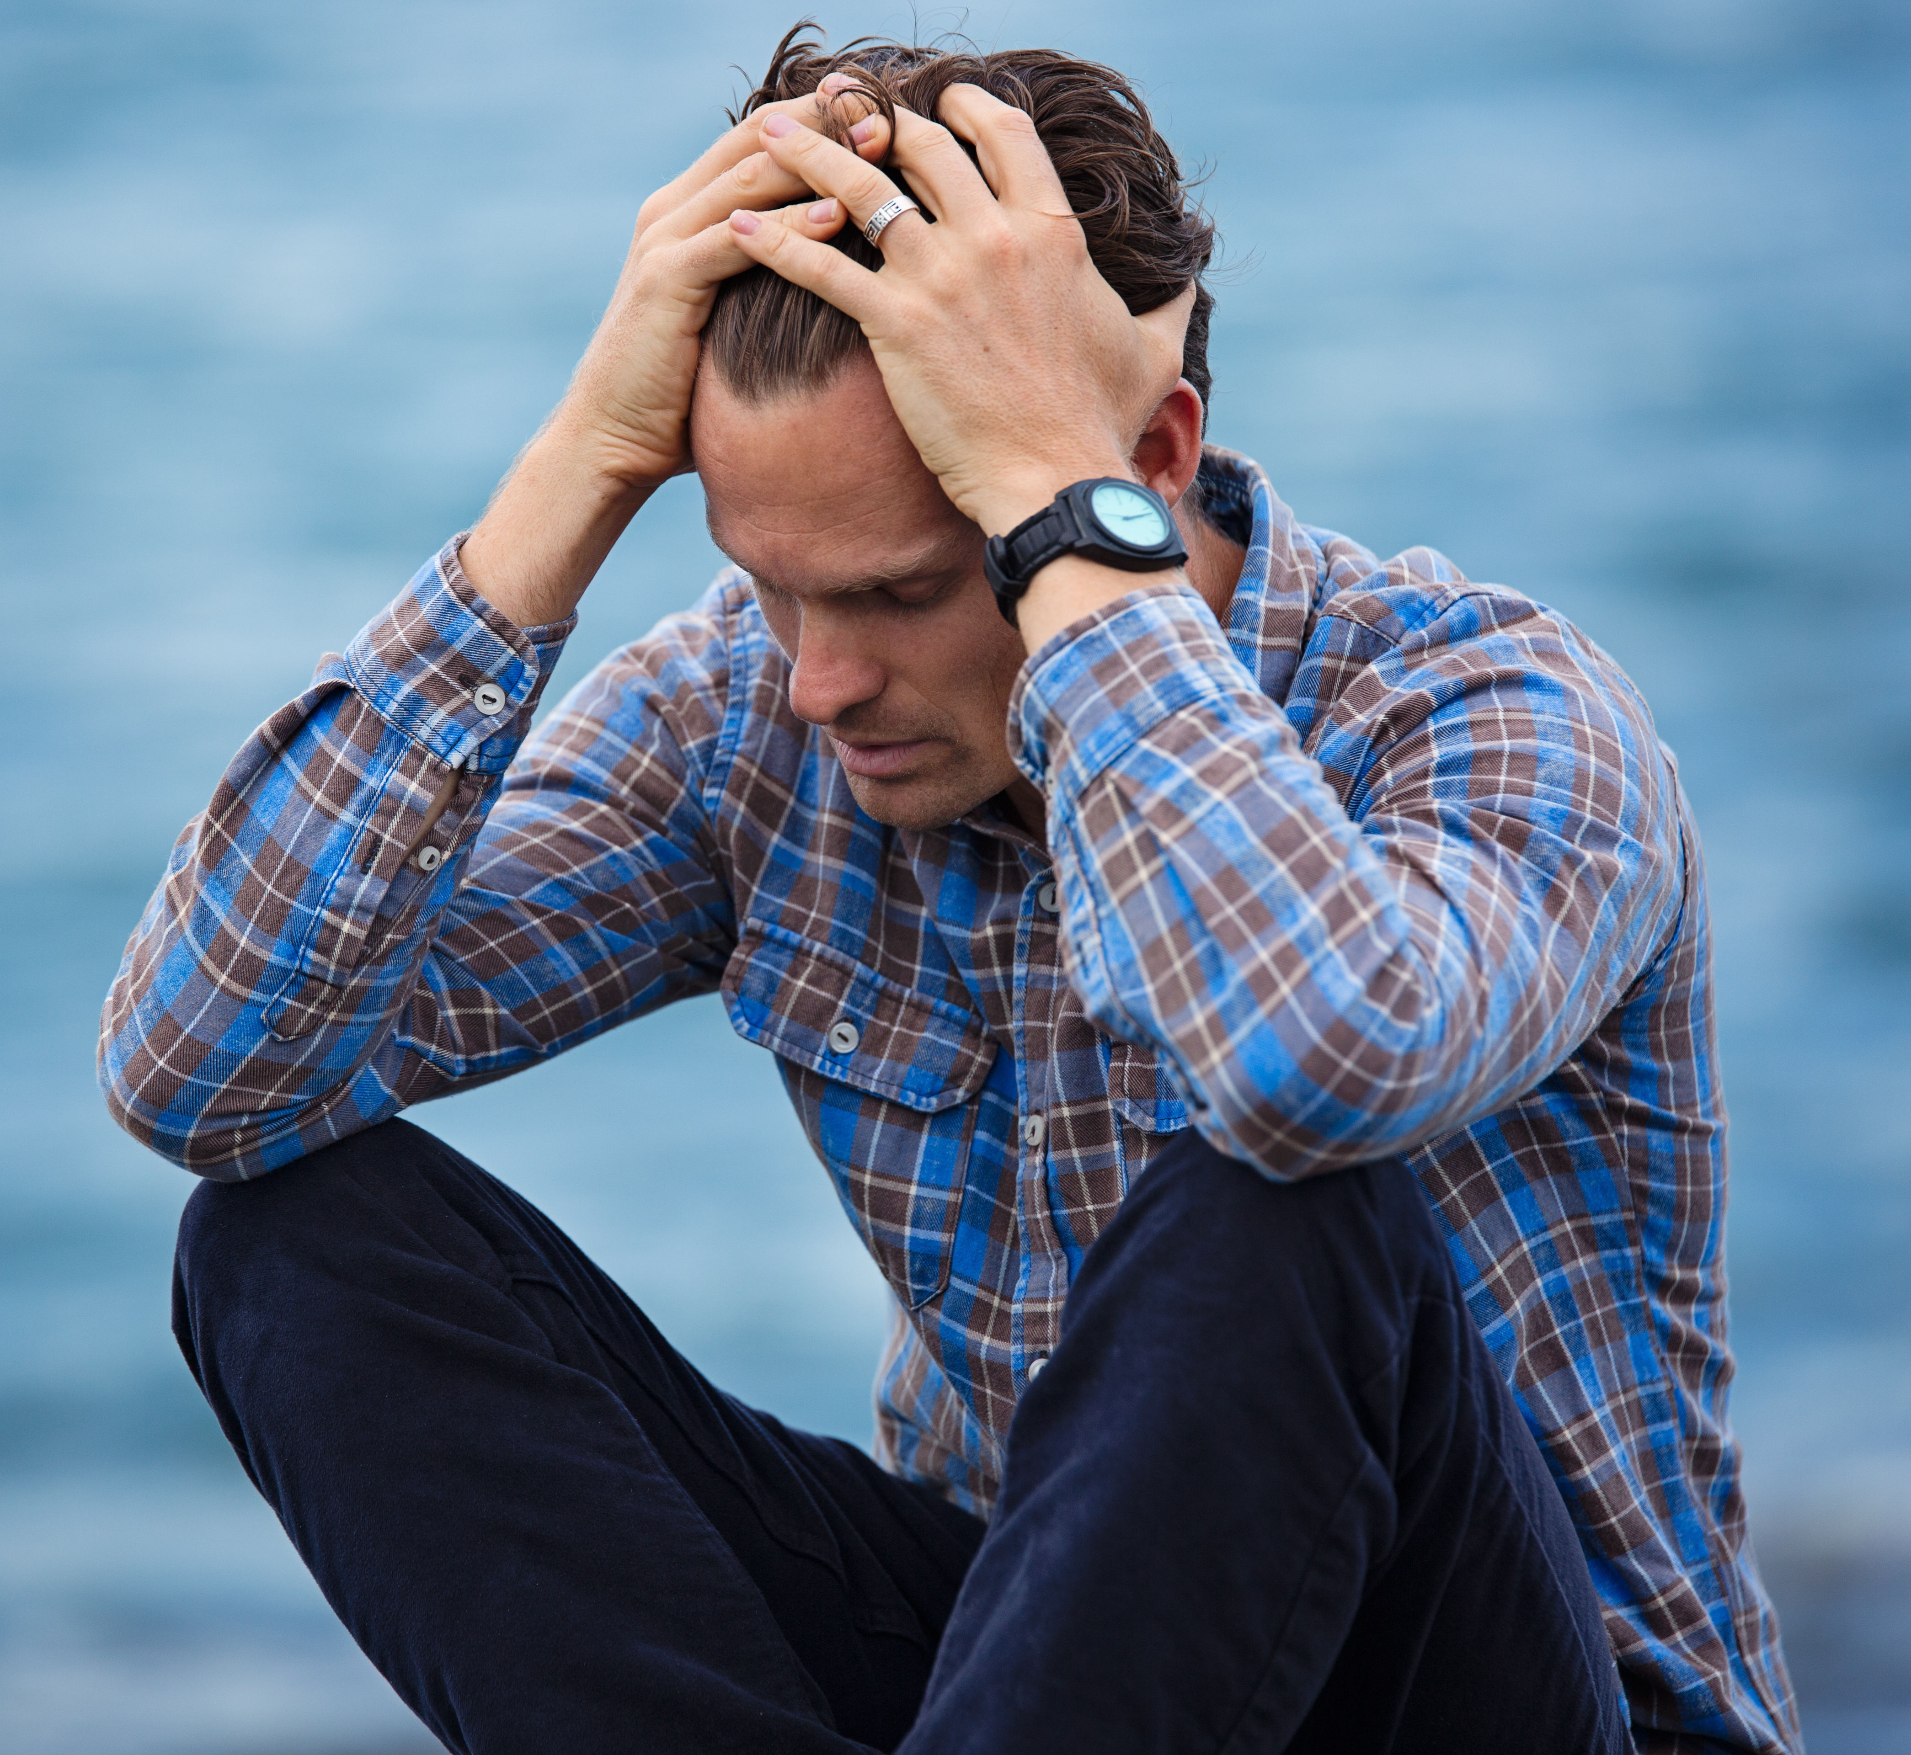
Why does being sleepy make me feel more worried?
Relative to a person who has had a full night’s sleep, the amygdala (the emotional part of the brain) is 60% more reactive.
Under conditions of a lack of sleep and sleep deprivation, the brain also shuts down the prefrontal cortex’s (PFC) communication with the amygdala. Usually the PFC would act as a break on the accelerator/gas pedal of your emotions.
Dr Walker states that “sleep has a profound story to tell in our understanding of, and maybe even in our treatment of, mental illness. In my lab, the most reliable thing we see when we deprive people of sleep in any dose is an increase in anxiety and beyond 14-15 hours of wakefulness, anxiety increases.”

Slide 20
Do sleeping pills help with more severe sleep problems?
Conclusively, no. They help with sedation, perhaps, but do not promote restorative immune-beneficial sleep, or naturalistic sleep.
There is not one sleeping pill with sound scientific data demonstrating benefits that far outweigh any health risks.
The most effective treatment is Cognitive Behavioural Therapy for insomnia, or CBT-I. Results, which have been replicated in numerous clinical studies around the globe, demonstrate that CBT-I is more effective that sleeping pills in addressing problematic aspects of sleep for insomnia.
So powerful is the evidence favouring CBT-I over sleeping pills for improved sleep across all levels, that in 2016, the American College of Physicians made a landmark recommendation that it MUST be used as the first-line treatment for all individuals with chronic insomnia, not sleeping pills.

Slide 21
Why are sleeping patterns affected differently when we travel to places with different time zone?
Travelling east to west is harder for the body to cope with than west to east.
This is because if you fly eastwards, it requires you to sleep earlier than you would naturally and this is very difficult as sleep will come earlier than your natural circadian rhythm. In contrast, the westward direction requires you to stay up later, which is a conscious and easier prospect.
Secondly, when we are away from any outside influence, our circadian rhythm is slightly longer than 24 hours, and so therefore it is easier to artificially stretch a day than to shrink it.

Slide 22
Why do I still wake up tired after a good night’s sleep?
There are different cycles in a night of sleep, and each of these has a different purpose.
There are 4 NREM stages (non-rapid eye movement stages), the 3rd and 4th of these are your deep restorative sleep for your body, and there is one REM cycle which is when your brain sorts what has happened during the day and transfers memories from your short to long-term memory. It is also when you might dream.
If you were to disturb any of these cycles therefore, they would impact different things. If you woke during STAGE 3 or 4 NREM cycle to go to the toilet, you may feel less refreshed in the morning.

Slide 23
Does the so-called sleep paralysis exist?
During REM sleep, the brain paralyses the body to keep you from acting out your dreams.
Normally, when we wake from our dreams, the brain releases the body from paralysis in perfect synchrony, right at the moment when waking consciousness returns.
However there can be rare occasions when the paralysis of the REM state lingers on despite the brain having terminated sleep, rather like that last guest at a party who seems unwilling to recognise that the event is over and it is time to leave the premises.
As a result, you begin to wake up but you are unable to lift your eyelids, turn over, cry out or move any of the muscles that control your limbs.
Gradually the paralysis of REM sleep does wear off and you regain control of your body, including your eyelids, arms, legs and mouth.
One in four healthy adults will experience sleep paralysis, which is to say that it is as common as hiccups.

Slide 24
Can lack of sleep cause permanent brain damage?
A lack of sleep has a close association with a number of illnesses.
In one study, participants were restricted to 4 hours of sleep for just ONE night and they experienced a 70% reduction in natural killer cell activity and these cells are a critical part of your immune system.
If you typically get less than 6 hours of sleep at night, your risk for a variety of cancers increases.
If you are getting 5-6 hours of sleep a night the week before getting the flu jab, you are only producing half the normal antibody response, rendering the flu jab highly ineffective.
If you lack sleep, you tend to over eat by 200-300 calories per meal and choose to eat more starchy and sugary foods which can lead to weight gain and eventual obesity.
Insufficient sleep is one of the most significant lifestyle factors that contributes to Alzheimer’s disease.

Slide 25
Dr Matthew Walker – Famous Quotes
“EVERY single disease that’s killing us in the developed world has causal links to a lack of sleep”
“There is no physiological system that we’ve been able to measure that isn’t enhanced by sleep when you get it or demonstrably impaired when you don’t get enough”
“The shorter your sleep, the shorter your life”
“Sleep is the swiss army knife of health. No matter what the ailment, there is something more than likely in sleep’s toolbox that will deal with it.”
“Sleep is a life support system and it’s mother nature’s best effort yet at immortality”

Slide 26
Activity suggestions to accompany Dr Matthew Walker video

Slide 27
Activity suggestion for children under 5
Activity Outline | Resources | Learning outcome
To replicate a bedtime routine in the classroom | Pyjamas/night clothes, cuddly toys, bedtime stories, tooth brush, blankets/sleeping bags, iPad Simple image of brain, darkness and daylight | For children to understand the importance of a bedtime routine, the impact of distractions in the bedroom (especially technology), For children to understand how darkness in the night, and daylight in the day, helps the brain during sleep, and being outside during the day
Watch funny video of little children and babies falling asleep in strange places and to explain why this might be | A clip of a video like this one https://www.youtube.com/watch?v=vaU8D1vs1KQ, some questioning prompts, e.g. why might the little children be sleeping? Why is sleeping well at night important for things we want to do in the daytime? | To realise the impact of not sleeping enough in the nightt on daytime activities and to begin thinking about things that help us feel awake and healthy
To build or draw a house and align the different parts to the house to the pillars of sleep, food and activity | Lego bricks, pens and pencils, Three Little Pigs story | To enable children to see that if you don’t have a strong foundation (sleep) and walls (exercise and food), then the roof will fall off (poor health)
Notes:
https://www.youtube.com/watch?v=vaU8D1vs1KQ

Slide 28
Activity suggestions for students aged 6-10
Activity Outline | Resources | Learning outcome
To make up a funny story with all the things that have happened in a day to help understand how the brain processes what has happened in the day during the dreaming phase of sleep | Little cards or pictures with a range of typical day activities – e.g. arriving at school by car, playing football, speaking with teacher, having lunch, stroking a dog on the way home, having a bath. The children could then arrange them in a different pattern with the help of teacher e.g. the dog in the bath, playing football in the car | For children to understand that dreams, although confusing, are just the brain’s way of making sense of what happens in the day.
To make and keep a sleep diary for a week and try to match the things that help with sleep on the days they felt best and learnt the most effectively | Card, pens, pencils, 7 day table showing days of the week and a rating The ‘top tips for sleep’ card | To understand how important sleep is to good health, and make the connection between good sleep, feeling and learning better
To write a creative story about a character who is not sleeping properly, and how a sleep magician helps him improve his sleep | The video, and the slide with sleep tips (found in resource section). The first part of the story could be written before GBWD and then discuss after the video what the magician might suggest | To recognise things that can impair good sleep

Slide 29
Activity suggestions for students aged 11-14
Activity Outline | Resources | Learning outcome
To discuss the feasibility of the Matthew Walker Smart Phone Challenge and working out a way to assess the challenge as per the criteria in slide 8 in small groups | Video link of Dr Walker issuing a challenge to our students in the Cognita video (11minutes). Pens/Paper/Computer to create a spreadsheet/table in groups that could measure key outcomes | To assess whether sleeping without phone in bedroom, or delaying checking phone for 10 minutes after waking, helps improve mood and emotion
Sleep myths or facts | Sleep myths factsheet (provided in resources section) | To learn which common sleep tales are true, which are not and why
Data collection and presentation of sleep habits of each class to compare with other Cognita countries | Sleep Questionnaire (resources) Presentation of data about number of average hours each class sleeps, in a pie chart | To enable students to assess the quality of their collective sleep as a class and compare with other Cognita countries To further attribute reasons for the findings based on sleep science
Student-led debate about why teenagers should start school later | Use information from slides and articles in resource section | To understand why teenagers find it especially hard to get up for an early start for school and how to make it less difficult

Slide 30
Activity suggestions for students aged 15-18
Activity Outline | Resources | Learning outcome
Assessment of Sleep | SATED Questionnaire | To enable students to identify the key elements of sleep that are critical to wellbeing
To discuss the feasibility of the Matthew Walker Smart Phone Challenge and working out a way to assess the challenge as per the criteria in slide 8 in small groups | Video link of Dr Walker issuing a challenge to our students in the Cognita video (11minutes). Pens/Paper/Computer to create a spreadsheet/table in groups that could measure key outcomes | To assess whether sleeping without phone in bedroom, or delaying checking phone for 10 minutes after waking, helps improve mood and emotion
Why ‘pulling an all-nighter will never work’ – Discuss Using this title, either write or discuss in small groups why Dr Walker stated this | Interview with Dr Walker Matthew Walker Book – Why We Sleep | To rationalise why staying up all night is counterproductive to learning and memory
To understand the impact of modafinil – a drug that artificially keeps students awake * Suitable for Sixth Form pupils | Stimulus video from the BBC outlining the dangers of modafinil https://www.bbc.co.uk/news/magazine-35091574 | For students to realise that there is not a healthy and safe way to cut down on sleep, and to be aware of the side effects of drugs like modafinil

Slide 31
Resources

Slide 32
Global Resources – Students aged 6-14
Resource Title & Link | Resource Description
Sleeping Tips (next slide) | Helpful things for children to try to improve their sleep
Sleep for Kidz Online Resource: http://sleepforkids.org/html/games.html | Selection of sleep quizzes, games and activities
Sleep – Myths or Facts (slides 33-35) | Selection of sleep points and reasons why they are true or false
Articles about why or why not schools should start later for teenagers: https://www.tes.com/news/why-it-makes-perfect-sense-allow-teenagers-lie-and-later-start-school-day https://www.telegraph.co.uk/science/2017/04/14/teenagers-should-start-school-later-avoid-car-crashes-suicide/ https://www.verywellfamily.com/the-pros-and-cons-of-starting-school-later-2609565 | A selection of articles discussing the pros and cons of later start times for schools

Slide 33
Sleeping Tips – Students aged 6-14
Tip | Reason
Try to go to bed and wake up at the same time every day, and develop a sleep routine | Your body has a special sleep clock called your ‘circadian rhythm’ and it works much better if sleep patterns don’t change a lot, and the brain gets used to a regular routine which aids restful sleep
Try to keep your room dark at night and get plenty of fresh air and daylight in the daytime | This is so that your brain doesn’t get confused about what time you should go to sleep and be awake
Try to keep the area around your bed clear of toys and distractions and do not have screens in the bedroom, including iPads and phones | This is to make sure you don’t get tempted to start playing with toys and games rather than sleeping and the light in electronic devices makes it very difficult for you to get to sleep
Try not to be too hot in bed | The ideal temperature to sleep is around 17 degrees Celsius. When you are asleep, your brain doesn’t regulate temperature in the same way so it’s key that you do this externally before you go to bed
Do not drink fizzy drinks or eat sugary food before bed | These sugars make it very difficult for your brain to be able to go to sleep

Slide 34
Sleep - Myths or Facts? (linked to activities for students aged 11-14)
Point | Myth or Fact | Reason
During sleep, your brain rests. | Myth | The body rests during sleep, however, the brain remains active, gets "recharged," and still controls many body functions including breathing. When we sleep, we typically drift between two sleep states, REM (rapid eye movement) and non-REM, in 90-minute cycles. Even in the deepest non-REM sleep, our minds can still process information. REM sleep is an active sleep where dreams occur, breathing and heart rate increase and become irregular, muscles relax and eyes move back and forth under the eyelids.
Does counting sheep actually help you fall asleep? | Myth | When you instruct people to do this, they don't fall sleep faster. In fact, in an experiment, it took them longer in many cases. The study concluded that whilst this was a myth, imagining a nice walk in the countryside could help, as well as meditating.
Does eating cheese give you nightmares? | Myth | There is NO data supporting this at all.
Notes:
http://sleepdisorders.sleepfoundation.org/chapter-1-normal-sleep/stages-of-human-sleep/

Slide 35
Sleep - Myths or Fact? (linked to activities students aged 11-14)
Point | Myth or Fact | Reason
Snoring is a common problem, especially among men, but it isn’t harmful. | Fact and Myth | It is usually harmless but can be a symptom of sleep apnea, especially if it is accompanied by severe daytime sleepiness. Sleep apnea can be treated; men and women who snore loudly, especially if pauses in the snoring are noted, should consult a physician.
Teens who fall asleep in class have bad habits and/or are lazy. | Myth | According to sleep experts, teens need at least 8 to 10 hours of sleep each night, compared to an average of seven to nine hours each night for most adults. Their internal biological clocks also keep them awake later in the evening and keep them sleeping later in the morning. However, many schools begin classes early in the morning, when a teenager's body wants to be asleep. As a result, many teens come to school too sleepy to learn, through no fault of their own

Slide 36
Sleep - Myths or Facts? (linked to activities students aged 11-14)
Point | Myth or Fact | Reason
Do ocean noises help you sleep? | Possibly | People enjoy this, although there is no scientific data supporting it,. However, your deep sleep is a rhythmic pattern and it may mirror this amplifying your deep sleep waves, although they have to be very low in tone (ones that would not wake you up).
Are naps good for you? | Fact and Myth | They can give benefits for learning, memory, the autoimmune and cardiovascular system. But they can also prevent you having good sleep at night by not allowing the build up of adenosine which is the sleepiness chemical which peaks around 16 hours of wakefulness. Naps can dissipate the sleep pressure and make it harder to fall asleep but if you nap regularly, for 20-30 minutes earlier than 3pm in the daytime and are still able to fall asleep, then napping is fine.

Slide 37
Sleep Questionnaire
How many hours do you sleep per night?
Do you sleep with your phone next to your bed?
Do you ever have difficulty sleeping?
If you are feeling low or run down, would you think about how much you have slept as one of the first possible causes?
Do you have difficultly getting to sleep?
Do you have difficulty staying asleep?
What is likely to keep you awake at night the most?
Concerns about school work?
Concerns about family/home life?
Concerns about friends?
Concerns about the environment?
Other
The questionnaire can be a useful tools to help self-assess sleep quality and quantity, but if you have answered yes to questions 3,5 & 6 or are concerned about your sleep or your physical or mental wellbeing at all, please do go to speak to your parents, teacher or doctor.

Slide 38
Global Resources – Senior aged students
Resource Title & Link | Resource Description
Articles about why schools should or shouldn’t start later for teenagers: https://www.tes.com/news/why-it-makes-perfect-sense-allow-teenagers-lie-and-later-start-school-day https://www.telegraph.co.uk/science/2017/04/14/teenagers-should-start-school-later-avoid-car-crashes-suicide/ https://www.verywellfamily.com/the-pros-and-cons-of-starting-school-later-2609565 | A selection of articles discussing the pros and cons about later start times for schools.
My ‘smart drugs’ nightmare – Victoria Derbyshire BBC https://www.bbc.co.uk/news/magazine-35091574 | Stimulus video from the BBC outlining the dangers of modafinil * Suitable for the Sixth Form

Slide 39
Sleeping Tips – Students aged 14-18
Tip | Reason
Try to go to bed and wake up at the same time every day and establish a sleep routine | Your body has a special sleep clock called your ‘circadian rhythm’ and it works much better if sleep patterns remain constant. A regular routine better prepares your brain and body for sleep
Try to keep your room dark at night and get plenty of fresh air and daylight in the daytime | To make it the differences between night and day clear for your brain
Do not have screens in the bedroom, including iPads and phones | Blue light inhibits melatonin production, delaying sleep. Their mere presence can also raise anxiety levels hindering sleep. The temptation to check it during the night is higher
Avoid caffeine 12 hours before bedtime | Caffeine has a quarter life of 6 hours, so if you had a coffee at midday, a quarter of that coffee would still be in your system at midnight and caffeine blocks production of sleep-inducing chemical melatonin

Slide 40
SATED Questionnaire adapted for teenagers
Category | Question | Rarely/Never (0) | Sometimes (1) | Usually/Always (2)
Satisfaction | Are you satisfied with your sleep?
Alertness | Do you stay awake all day without dozing?
Timing | Are you asleep between 12am -6am?
Efficacy | Do you spend less than 30 minutes awake at night (including time it takes to fall asleep and wake from sleep)?
Duration | Do you sleep between 8-10 hours per day?
Poor Sleep (0) |  |  |  | Good Sleep (10)

Slide 41
How to assess your sleep
Dr Matthew Walker:
‘Short of a clinical sleep assessment, your responses to two questions can indicate a sleep problem’.
After waking up in the morning, could you fall back asleep at 10:00 or 11:00. If the answer is “yes,” you are likely not getting sufficient sleep quantity and/or quality.
Can you function optimally without caffeine before noon? If the answer is “no,” then you are most likely using caffeine because you aren’t getting enough sleep’
Important – the questions above and the SATED questionnaire are useful tools to assess sleep quality and quantity, but if you are concerned about your sleep, or your physical or mental wellbeing at all, please do go to speak to your parents, teacher or doctor.

